Slide 1
SAP Cloud Platform Essentials

Slide 2
Agenda
SAP Cloud platform introduction
Cloud foundry for SAP Cloud platform
SAP Cloud platform services
SAP Cloud platform Leonardo portfolio services

Slide 3


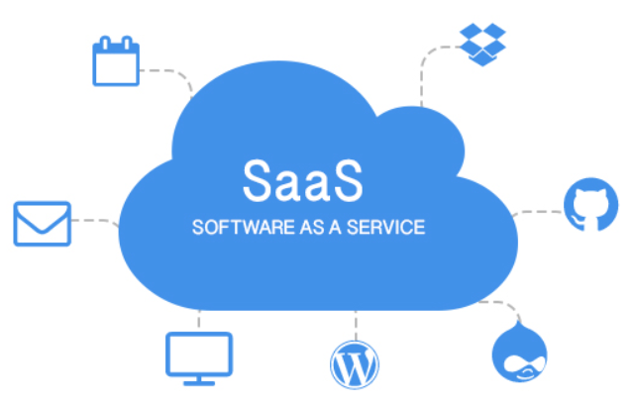
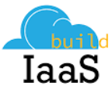
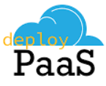
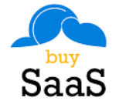
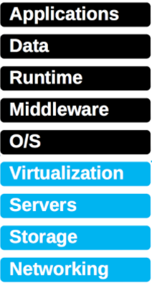
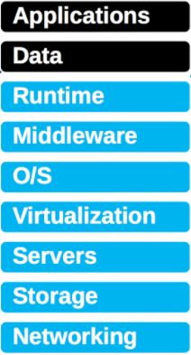
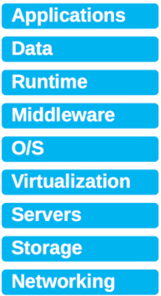
What is Cloud?
The hardware or the software provided as service and accessible through the internet
It offers online data storage, infrastructure, application servers, applications and services, which can be leveraged through subscriptions and accessed via internet
Three major categories of cloud computing
Infrastructure as service (SaaS)
Platform as service (PaaS)
Software as service(SaaS)
Examples
- Amazon
Web Services
- Microsoft
Azure
Managed by customer
Managed by customer
Managed by vendor
Examples
- Gmail
- Google Apps
- SAP Success
Factors
- SAP Ariba
Managed by vendor
Examples
- SAP Cloud
Platform
- IBM Bluemix
Managed by vendor

Slide 4

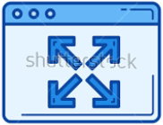

WHAT IS SAP Cloud Platform ?
SAP Cloud Platform, is a full featured, open standards based, in-memory cloud platform.
It is a Platform as a Service offering (PaaS) that provides both a development and runtime environment for cloud applications. It allows you to focus on developing your software and use an enterprise-ready pre-installed environment in the SAP cloud to deploy and run your applications in a secure and reliable way.
Eliminate Capital expenses
SAP Cloud Platform(PaaS)
No capital investment on hardware, as it is maintained and provided by the services provider
Build new cloud apps
Reduce operating expenses
Benefits
Central maintenance by provider
Automatic updates
Extend existing on premise and cloud apps
Flexibility
Meet changing demands as you grow
System accessible from everywhere
Integrate apps
Agility
React faster to changing business needs, by enhancing the existing application and building new ones with minimal efforts
Cloud infrastructure
High availability
System is always available

Slide 5
SAP Cloud Platform Architecture
Development
Operation
Commerce
SAP Web IDE/ SAP API Business Hub
Cockpit
Marketplace
On-Premise / Managed Cloud
SAP Cloud Platform
SaaS
Commerce
Localisation/ Tax
Data Quality
…
SAP S/4 HANA
Programming Models
Business Services
Dev /Ops
SAP S/4 HANA
Integration
Analytics
Mobile
IoT
Success Factor
HTML XSC/XSA
Platform
Services
Collaboration
Security
UX
Machine Learning
Development
Application Logging
Lifecycle Management
Profiling
Monitoring
Debugging
SAP Business Suite
SAP Hybris Cloud for Customer
SAP ASE
Redis
Big Data Services:
SAP HANA
Hadoop
SAP BW/4 HANA
JAVA XSJS / Node.js Python
Device & Storage Services
SAP Ariba
PostgreSQL
MongoDB
Concur
SAP Business Warehouse
SAP Fieldglass
SAP Business ByDesign
Virtual Machines
Amazon Web Services MS Azure Google Cloud Platform

Slide 6

Accounts, Regions and Environments
Enterprise Global Account
Cloud Foundry Subaccount
Neo Subaccount
More Cloud Foundry Subaccounts
Regions
location of the data center
Cloud Foundry Org
Neo Apps
Cloud Foundry Spaces
Neo Services
Cloud Foundry Apps
Cloud Foundry Services
Europe (Frankfurt)
Europe (Amsterdam)
Europe (Rot)
Australia (Sydney)
Brazil (São Paulo)
Canada (Toronto)
Russia (Moscow)
US East (Ashburn)
US West (Chandler)
US East (Sterling)
…
Environments
Cloud Foundry Environment
BYOL with multiple runtimes
IoT and Machine learning scenarios
Hana XS Advanced application development
Containerization
Neo Environment
HTML based XS application
Java application
Infrastructure support By SAP
Support for Java, HTML5 and HANA XS
ABAP Environment
ABAP-based applications and extensions
Support for ABAP runtime only

Slide 7
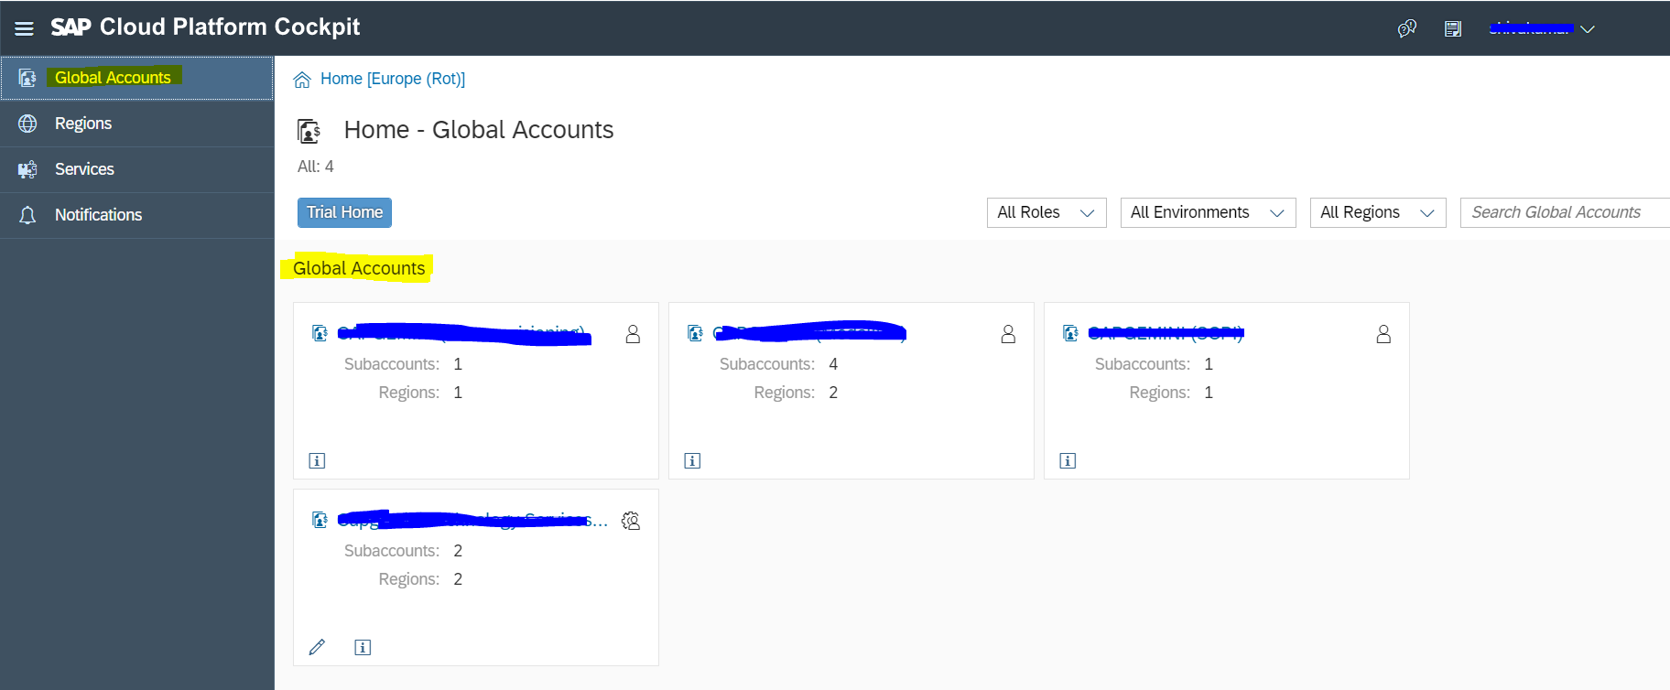
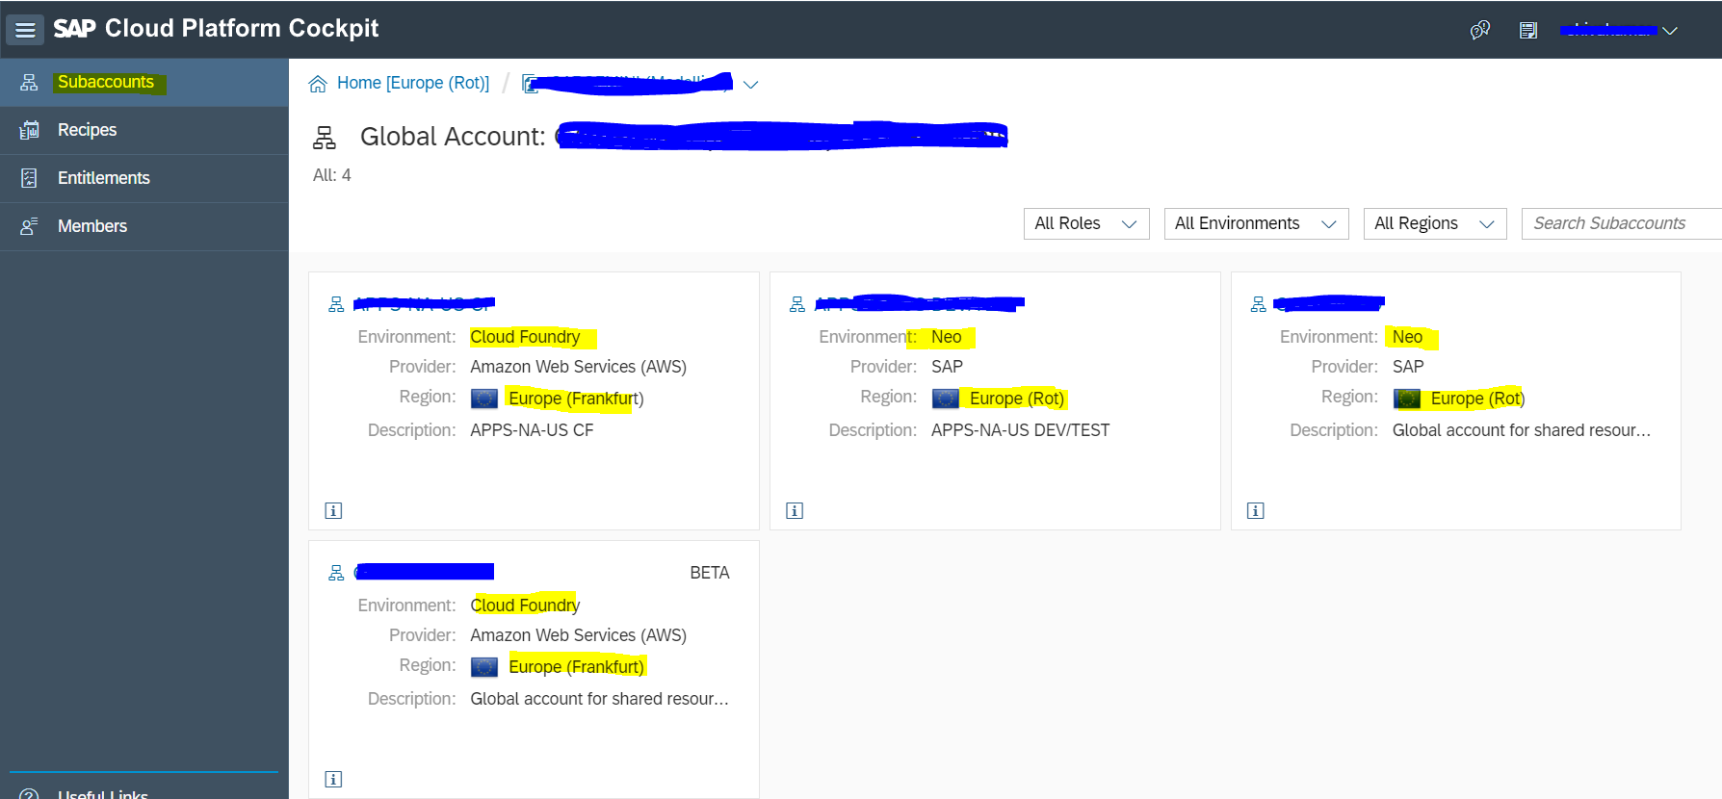
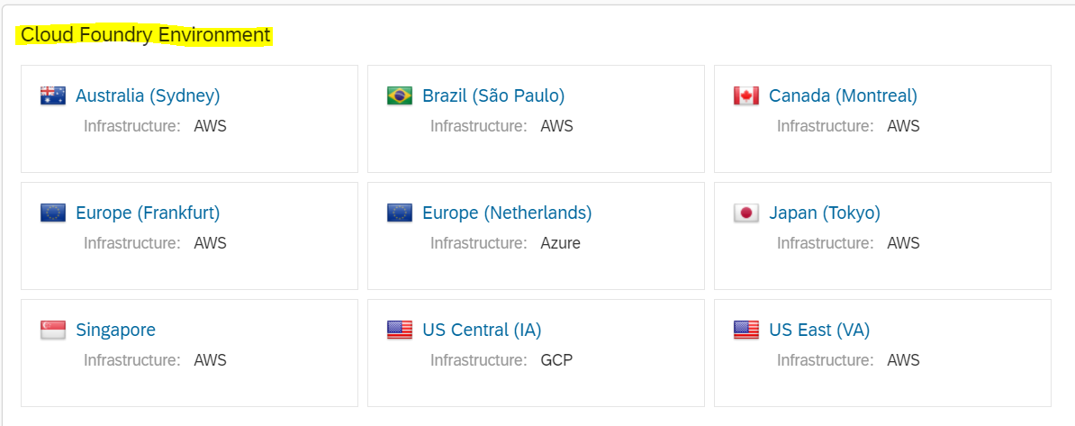
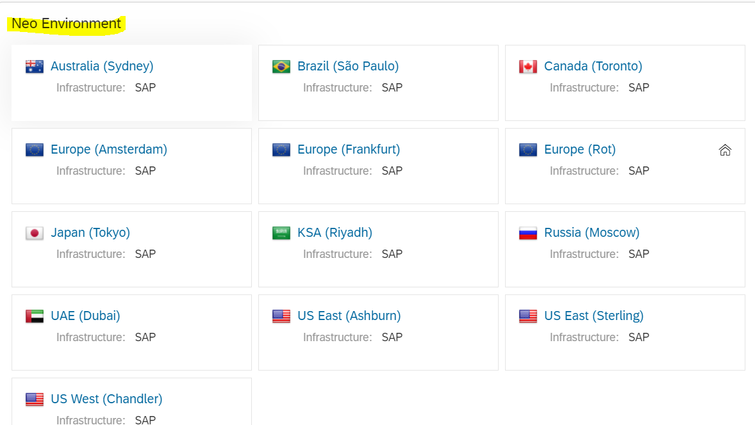
Accounts, Sub Accounts and Regions
Global Accounts under home page
Sub Accounts(Neo and Cloud Foundry) under one global account
Regions available for Cloud foundry Environment
Regions available for Neo Environment

Slide 8

Cloud foundry for SAP Cloud platform
What is cloud foundry?
Cloud Foundry is an open source cloud platform as a service (PaaS), which supports multiple development platforms and multiple runtime environments allowing developers to code in multiple languages and frameworks.
SAP cloud platform and cloud foundry
SAP is platinum member of cloud foundry foundation.
SAP leverages cloud foundry as an operating system for its platform as service.
Why cloud foundry?
SAP adapted cloud foundry for its open standards and which is also adapted by most of the other PaaS vendors like IBM bulemix
Multiple IaaS vendors like AWS and Microsoft Azure are cloud foundry compliant and certified, which allows SAP to rapidly scale its cloud platform deployment on other infrastructures by eliminating vendor lock-in
Allows SAP to follow its multi cloud strategy, by making its cloud platform compatible with other cloud infrastructures in addition to its own datacenters.
Cloud Foundry : Value Propositions & Focus Areas
Value Proposition:
Focus Areas:
Continuation of open-source & open-standards-based PaaS strategy (Cloud Foundry is de-facto standard PaaS)
Digital Transformation: IoT & machine learning.
SAP Leonardo
More flexibility with regard to deployment models (multi-cloud) & programming model (BYOL).
Agile Business:
Native SAP HANA development (via HAS) based on SAP HANA 2.0
Also, greenfield scenarios leveraging a combination of open-source backing services and unique capabilities provided by SAP Cloud Platform
Reduced vendor lock-in (being a part of a cross vendor project via Cloud Foundry Foundation).

Slide 9

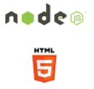



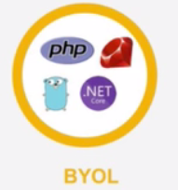
Runtimes offered
Neo Environment
Cloud foundry Environment
Develop deploy and use Java applications
In a cloud environment
Develop deploy and use Java applications
In a cloud environment
Develop and run Node.js and HTML5 applications
Run XSJS application via compatible layer in Node.js
Develop and scale XSJS applications
In a cloud environment, by reducing the footprint of a
solution by not having a separate application server
Develop and run python applications on cloud
Leverage multiple libraries available for data manipulation, machine learning and analysis.
Develop and run lightweight HTML/UI5 applications
Rapidly build applications by leveraging the UI5 code templates and SAP best practices
Bring your own language and runtime of choice
Choose from existing build packs or develop your own
All the logos are registered trade marks of their respective owners and/or their affiliates.

Slide 10
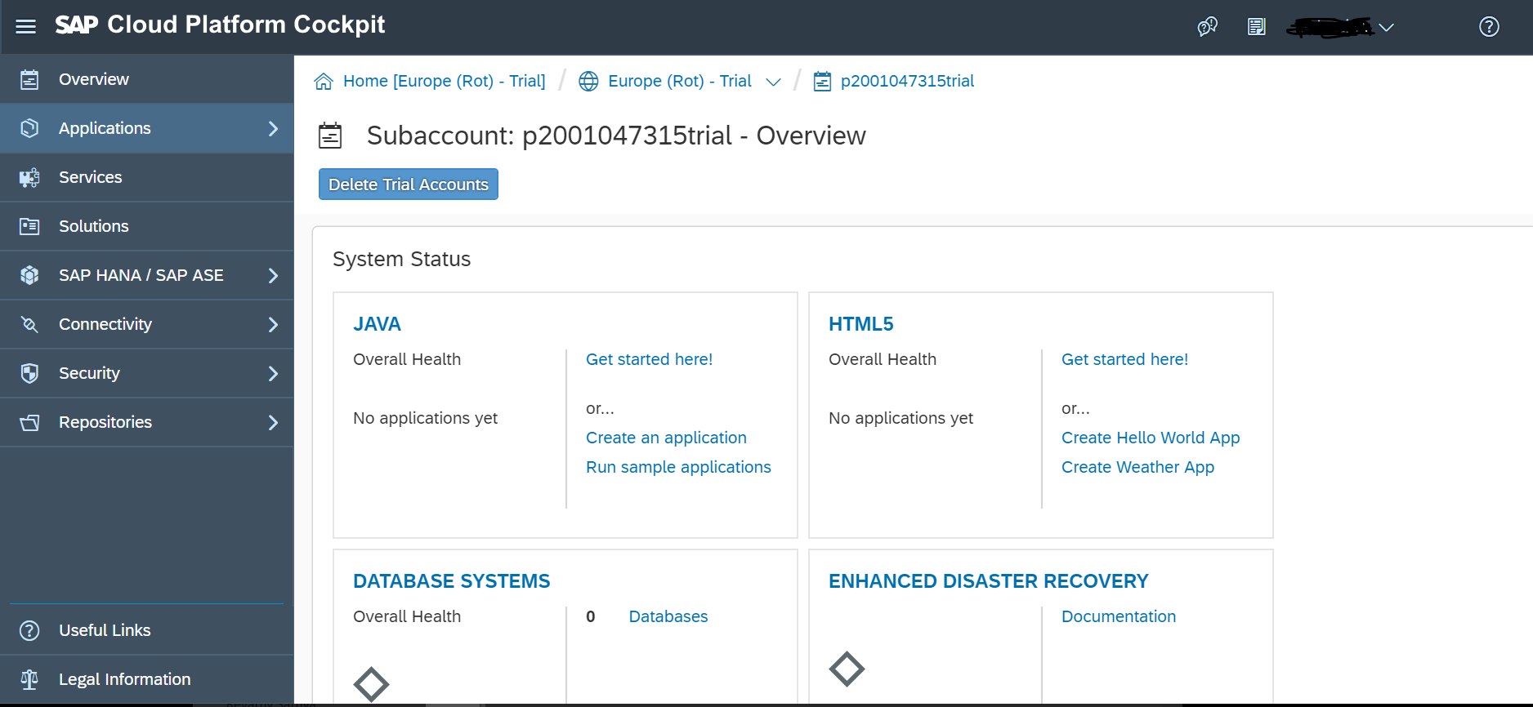
SAP Cloud Platform Cockpit
The SAP Cloud Platform cockpit is the consolidated destination for all operational needs, from configuration to deployment and monitoring on SAP Cloud Platform.
Key capabilities
Entry point to SAP Cloud Platform on the Web
SAP Cloud Platform and application configuration
Deployment of applications
Monitoring of resources, databases, and applications
Benefits
Complete overview and access point of SAP Cloud Platform
Easy Web-based operations administration

Slide 11
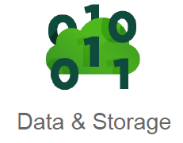
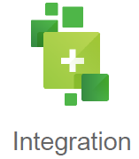

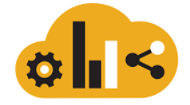
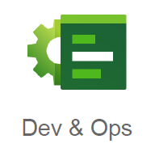
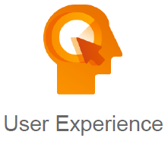


SCP Capabilities and Services
SAP HANA
Mongo DB
Big Data Services
Cloud Integration
Connectivity
OData Provisioning
Authorization and Trust management
OAuth Service
Web IDE
Life cycle management
Debugging Service
SAP Cloud Platform
Build Service
Portal Service
Fiori Mobile
Tax service
Data Quality service

Slide 12



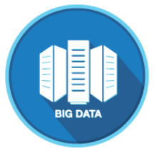
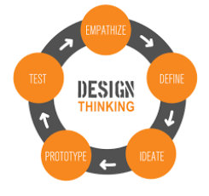


SCP Leonardo portfolio services
SAP Cloud platform IoT Services for building IoT based applications
Internet of things
SAP Leonardo machine learning foundation hosted on SAP Cloud platform
Ready to use RESTful API’s as functional and business services
Machine learning
Analytics cloud
Predictive analytics (PAL)
Analytics
SAP Data Hub
Creating value out of Diverse data landscape with orchestration and pipelining solution
BigData
SAP Cloud Platform
THE DESIGN THINKING APPROACH
Human-centric
Highly collaborative
Iterative: fail fast, fail early
Design Thinking
Data as service revenue stream(Daas)
Data Intelligence solutions to monetize data and insights
For companies in public domain and social networking
Data Intelligence
BaaS(Blockchain as services) hosted in SAP cloud platform for enterprise blockchain adoption.
Blockchain

Slide 13
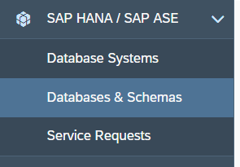
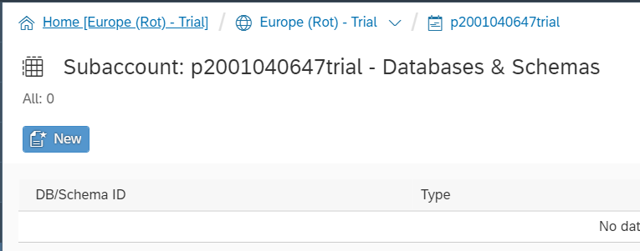
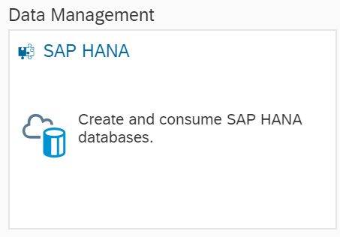
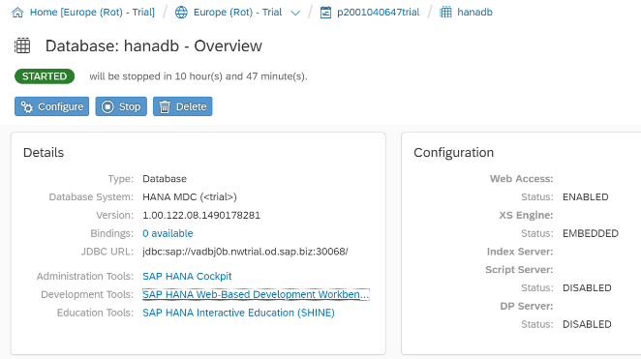
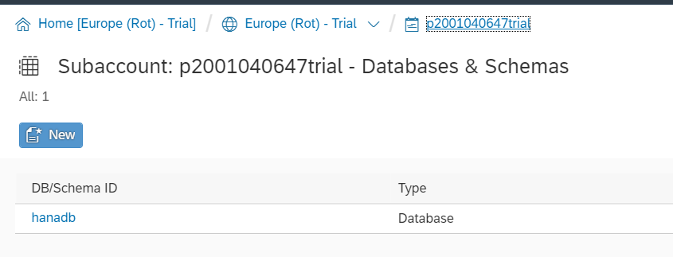
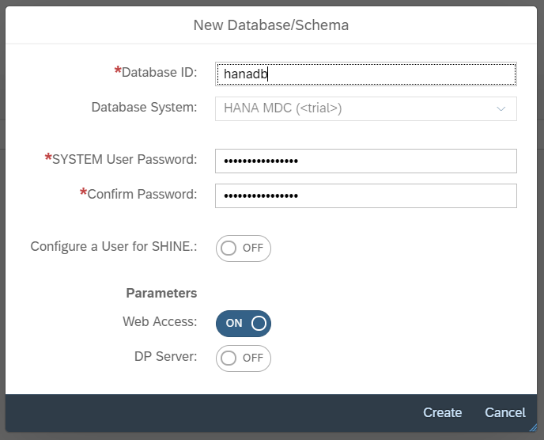
SAP Hana - Service Enablement:
Prerequisite
Trial or Enterprise account access.
SAP Cloud Platform
Login into SAP CP and
Click on Neo Trail. In services Search for HANA
Services
By Default this service will be enabled and we can see the Database under SAP HANA/SAP ASE
Database Creation
Click on the Databases and Schemas to add a new Database
Database Creation
Give the required details and click on create
HANA Cockpit and Workbench
Click on the created DB and navigate to workbench to start development

Slide 14
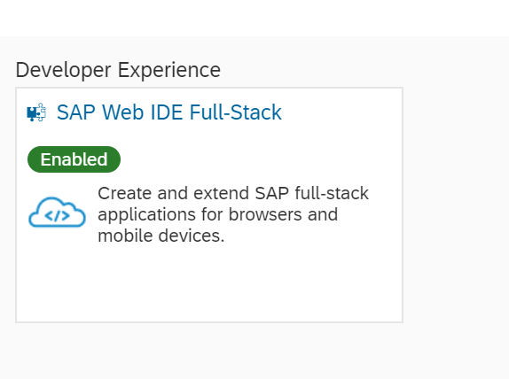
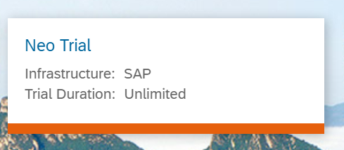

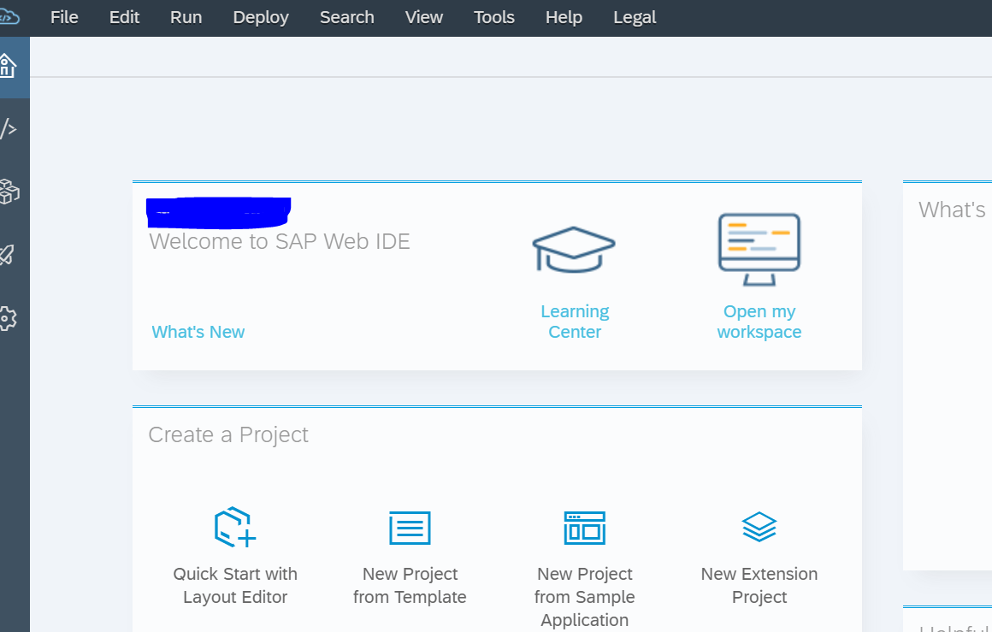
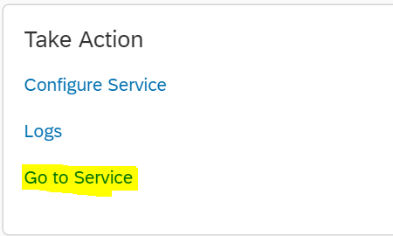
SAP Web-IDE Service Enablement:
Prerequisite
License/Subscription to Web-IDE Service.
Can be enabled and leveraged only for Neo environment.
SAP Web IDE Full-Stack
Search for SAP Web IDE Full-Stack
in the service marketplace
SAP Cloud Platform
Login into SAP CP and
Click on Neo Trail
Services
To see all the services available,
Click on Services tab.
SAP Web-IDE
Generated the workspace, It helps you to create a project and respective schema.
Enable the service
In order to use the service scroll down to “Take Action” tile and click on “Go to Service”.

Slide 15
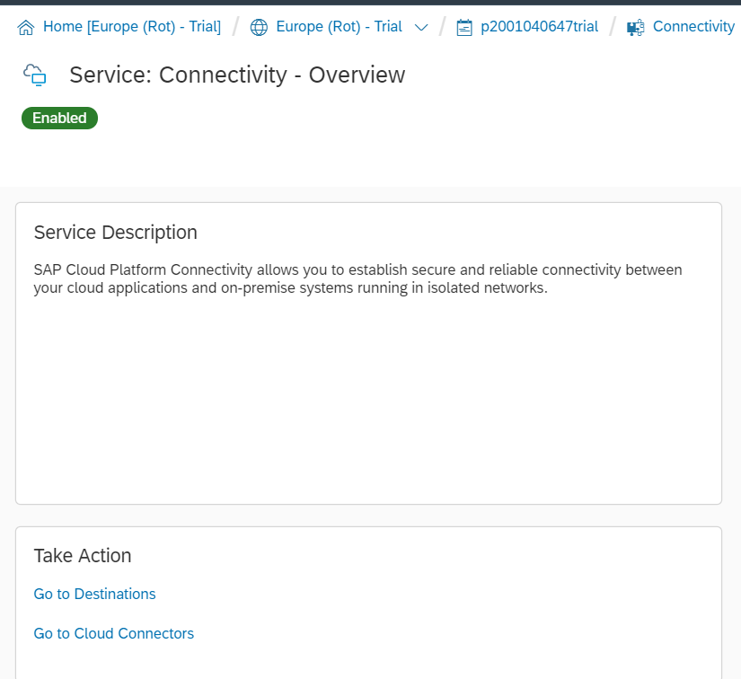
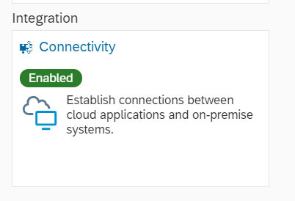
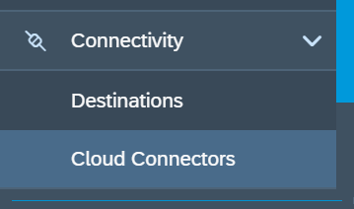
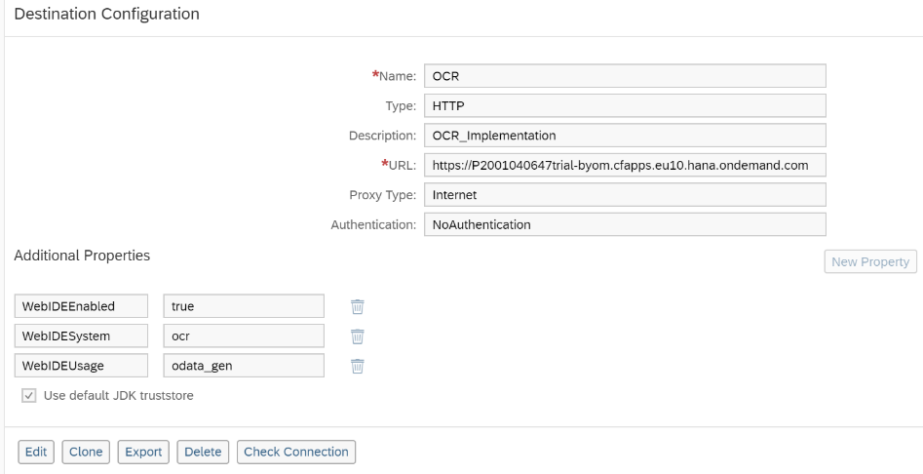
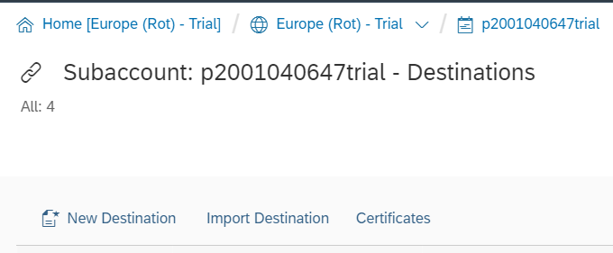
SAP Connectivity Service Enablement
Prerequisite
Trial or Enterprise account access.
Connectivity
SAP Cloud Platform Connectivity allows you to establish secure and reliable connectivity between your cloud applications and on-premise systems running in isolated networks.
SAP Cloud Platform
Login into SAP CP and Click on Neo Trail. In services Search for Connectivity
Destinations
Destinations are used to allow connectivity between Hana Applications and External networks. On the left is an example of destination, which is calling an API.

Slide 16
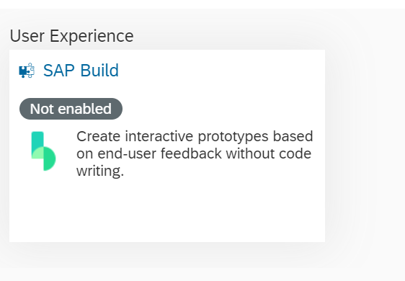
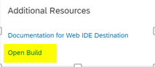
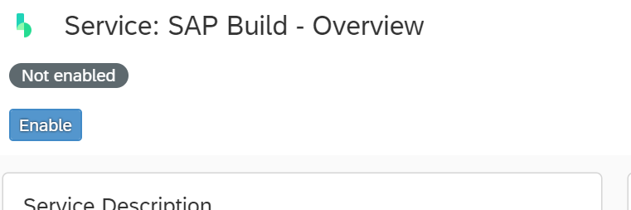
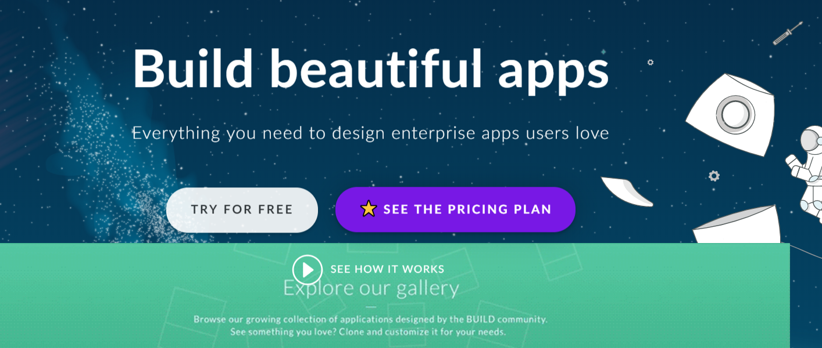
SAP Build Service Enablement:
Prerequisite
License/Subscription to Web-IDE Service.
Can be enabled and leveraged only for Neo environment.
SAP Cloud Platform
Login into SAP CP and
Click on Neo Trail
Services
To see all the services available,
Click on Services tab.
SAP Web IDE Full-Stack
Search for SAP Build
in the service marketplace
Utilize the service
Click on “Open Build” in order to use the service
Enable the service
Enable the service by clicking on “Enable”

Slide 17
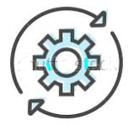

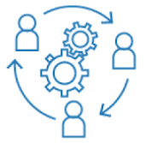





Cloud application development
Why develop business applications on cloud?
Leverage UX Services like “Build” to create reusable prototypes with minimal efforts within short intervals
Fast Innovation cycles
Continues Delivery
Reusable Prototypes
Leverage DevOps services for development and operational tasks
DevOps Services
Minimal Viable Product
Reuse existing and standard applications and services
Business Agility
Reduced Total cost of development
Reuse
Leverage standard API’s from SAP Business Hub to connect to various other services
IDEA
API’s

Slide 18


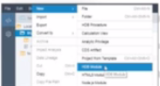

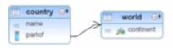
SCP Development Environments
SAP Cloud platform Web IDE Multi-Cloud version
Supports SAP’s technologies (Fiori, UI5, HANA,Odata) as well as open source technologies like JS and JAVA
Full Stack development and deployment for cloud foundry environment
SAP Fiori and UI development and deployment for Neo environment
Web IDE Multi-Cloud version is a full stack development environment for Cloud foundry environment, which enables to create front end applications, Business logic and back end data models all at one single place
UI Front end apps
Odata/XSJS
Business logic
SQL/JDBC
SAP Cloud Platform
Cloud Foundry
Web IDE Multi-Cloud version
Backend data modeling

Slide 19
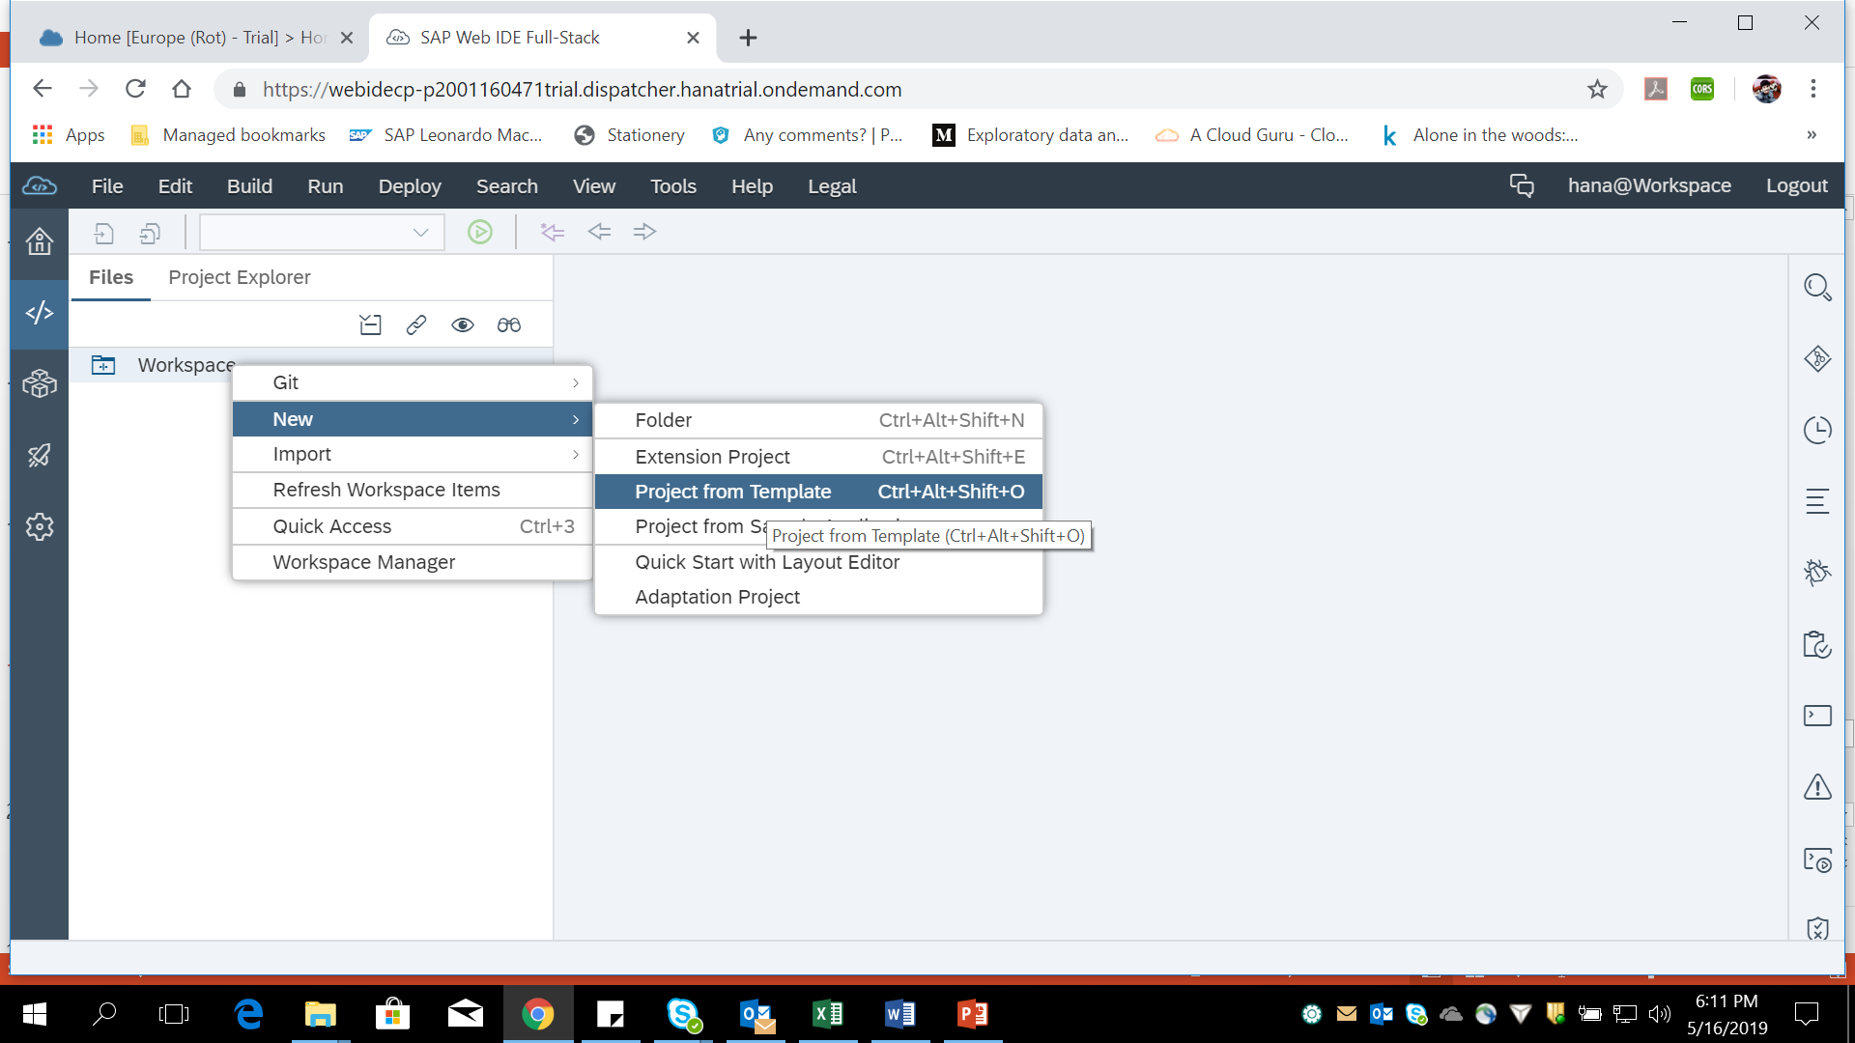
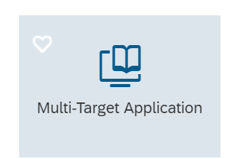
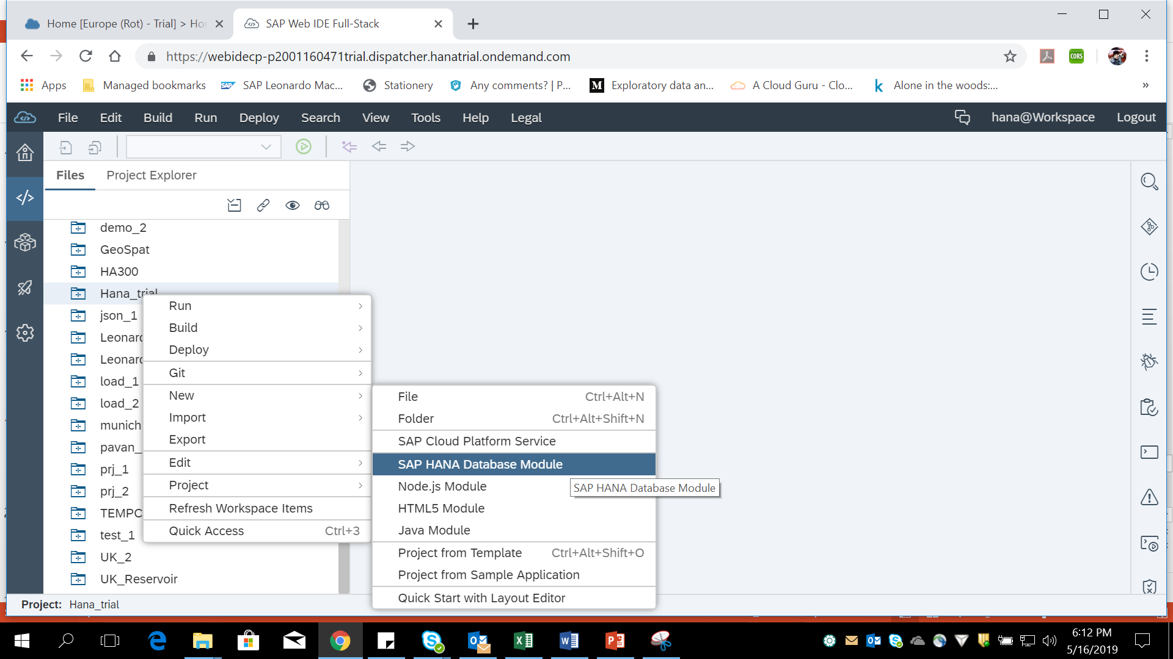
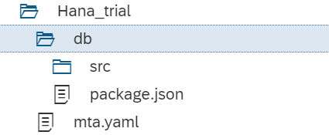
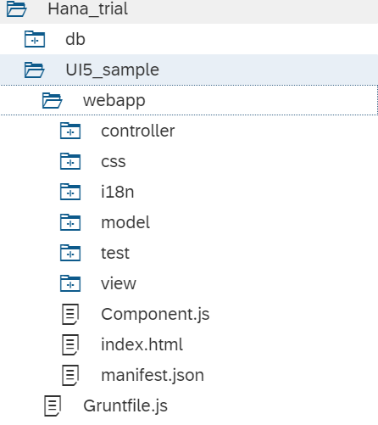


Development Scenario:
Creation of Multi Target Application
Creation of DB Module
Creation of HTML5 Module

Slide 20




SCP Development Environments
Key capabilities
Zero installation and upgrades
Develop new apps and extend the existing ones
Drag and drop tools, wizards and templates for faster developments
Code editor optimized for SAPUI5
Key Benefits
Reduced cost and complexity efforts
Increase in productivity
Improves team productivity
Develop once and deploy on multiple SAP platforms like Cloud, ABAP, Mobile and Enterprise portal
Develop
Test
Deploy
Extend
Web based Integrated development tools

Slide 21
ID SAP
SAP Leonardo
Thank you

